Slide 1
Introduction to Cloud Computing

Slide 2
Cloud Computing in a Nutshell
Next generation of computing after Mainframe, Personal computers, Client-Server and the Web
New platform & delivery model providing dynamically scalable & often virtualized resources
No CAPEX, only OPEX
1000 servers for 1 hour = 1 server for 1000 hours!
Commoditization of IT
Economies of Scale
Agility – Accessibility – Elasticity – On-Demand

Slide 3
Seeds
Software matured over the last 2 decades
Especially virtualization & scalable distributed systems
Leading to onset of cheaper consumer hardware
Large companies like Amazon & Google had spare capacity
Actual reason for Amazon’s public cloud offering
Economies of Scale
Amazon, Google, Microsoft have huge data-centers
Hundreds of thousands of servers
5x-7x reduction in IT costs
Reduced administrator costs with 10-20x reduction in per server admin costs

Slide 4
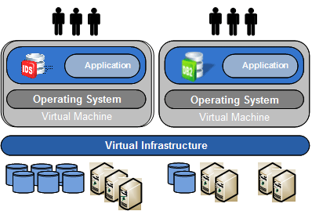
Virtualization
Advantages
Consolidation
Reduce TCO
Business Continuity
Increase efficiency & agility
Server, Storage, Network
Leading Vendors
VMWare: vSphere, vCenter
Citrix: Xen
KVM
Cisco: Unified Computing System (UCS)
Hyper-V

Slide 5
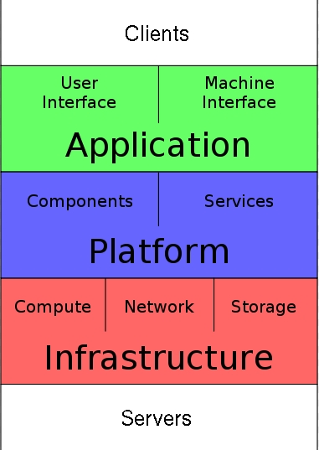
Cloud Stack
Infrastructure-as-a-Service (IaaS)
Utility Computing
Service provider owns & maintains the equipment
Platform-as-a-Service (PaaS)
Computing platform & software stack as a service
Software-as-a-Service (SaaS)
On-demand software with data hosted by the vendor

Slide 6
Infrastructure-as-a-Service
Pay-as-you-go Virtualized Resources – CPU, Storage, Network
Infrastructure management services & tools
Application cannot dynamically scale on-demand
Local Server moved into the cloud – managing, patching, securing, monitoring is still a responsibility
Extremely flexible
Very little vendor lock-in
Examples: Amazon EC2, Terremark vCloud, GoGrid Cloud, Rackspace Cloud

Slide 7
Platform-as-a-Service
Scalable platform, hosted framework to develop and deploy applications
Development language and platform decided by vendor
No infrastructure management headaches
No licensing concerns
Scalability & availability are managed by the vendor
Little flexibility – limited to choices provided by vendor
Vendor lock-in concerns
Examples: Google AppEngine, Microsoft Azure, Heroku

Slide 8
Software-as-a-Service
Consumer facing – Business oriented
Business layer is provided – extensions can be written
Very similar to traditional hosting but with cloud models
Consumed over the web
No flexibility
Almost complete vendor lock-in unless vendor follows standards for data extraction
Examples:
SalesForce, Google Apps, Box.net, ZOHO, Microsoft Office 365

Slide 9
Cloud Spectrum
IaaS PaaS SaaS
Amazon
GoGrid
Terremark
Rackspace
Cloud.com
Others…
Force.com
Google AppEngine
Microsoft Azure
EngineYard
Heroku
SalesForce
Google Apps
Microsoft Office 365
NetSuite
Many others….
Application User Interface, API
API, IDE, Libraries, Tools, Connectors
Business Layer
API, Connectors, Tools, Services
App Framework
App Framework
Compute
Compute
Compute

Slide 10
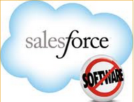
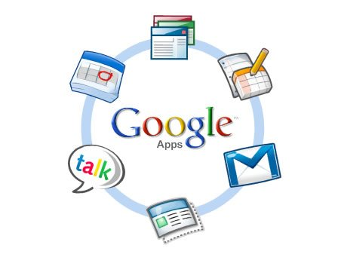

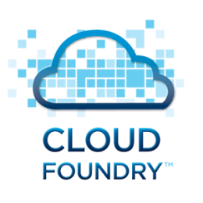





Cloud Vendors Across Spectrum
SaaS
PaaS
IaaS

Slide 11
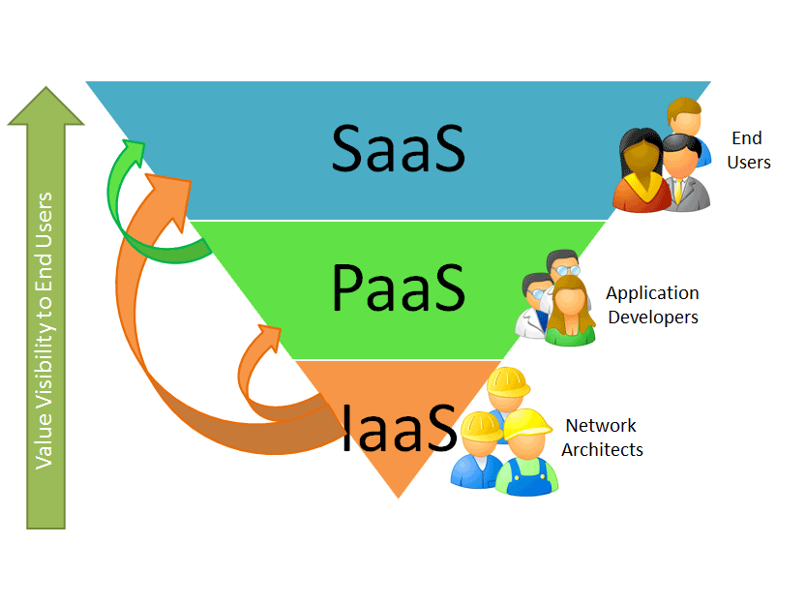
Cloud Layers - Visibility

Slide 12
Deployment Models
Public Cloud
Fine grained, self-service cloud available over the internet
Community Cloud
Shared infrastructure between similar organizations to avail benefits of scale and overlap
Hybrid Cloud
Multiple clouds used together in any way
Private Cloud
Operated and used by a single organization – setup internally or co-located

Slide 13
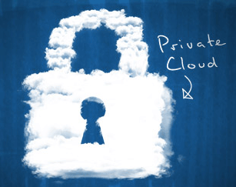
Private Clouds
Implement cloud services on dedicated resources
Pooled resources, Elastic, Self-Service, Customizable
Examples:
Microsoft Azure
Cloud.com
Eucalyptus
OpenStack

Slide 14
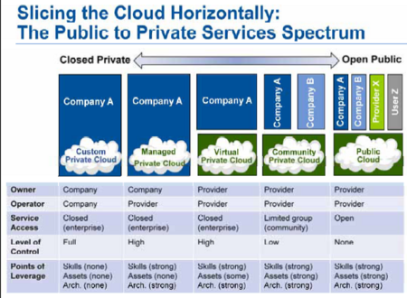
Private -> Public Spectrum

Slide 15
Cloud Storage
Storage – attractive to store in the cloud
Populated & consumed in the cloud
Enterprise usage increasing
No management overhead, backups, disaster recovery
Amazon S3 provides all in 11-15 cents/GB/month
Pricing to the tune of $5 per month for unlimited storage
High consumer penetration
Examples
Amazon S3, Rackspace CloudFiles
Carbonite, Mozy
DropBox

Slide 16
Cloud Economics

Slide 17
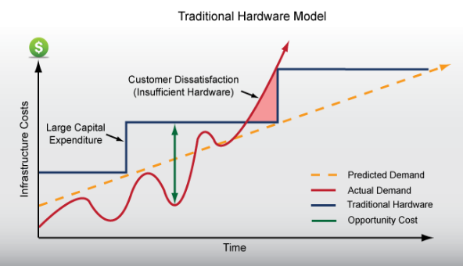

Slide 18
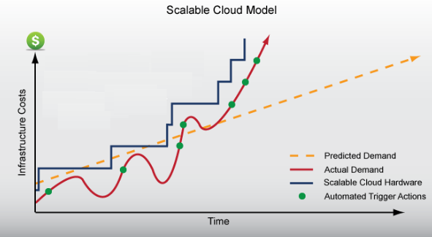

Slide 19
Effects of Cloud Paradigm
Economies of scale
5-7 times decrease in cost as compared to data centers
Pay as you go
1 hour of Amazon EC2 can cost as less as 8.5 cents or 4 rupees!
No CAPEX, only OPEX
Higher utilization & automation – lower TCO
Agility: Practically infinite scalability – go from 1 machine to 1000 in an hour!
That is fast provisioning!

